Slide 1
Software Design & Architecture
Lecture # 08
Logical Architecture and UML Package Diagrams

Slide 2
Outline
Requirement to Design Iteratively
Logical Architecture
UML Package Diagram
Layered Design
Model-View Separation Principle

Slide 3
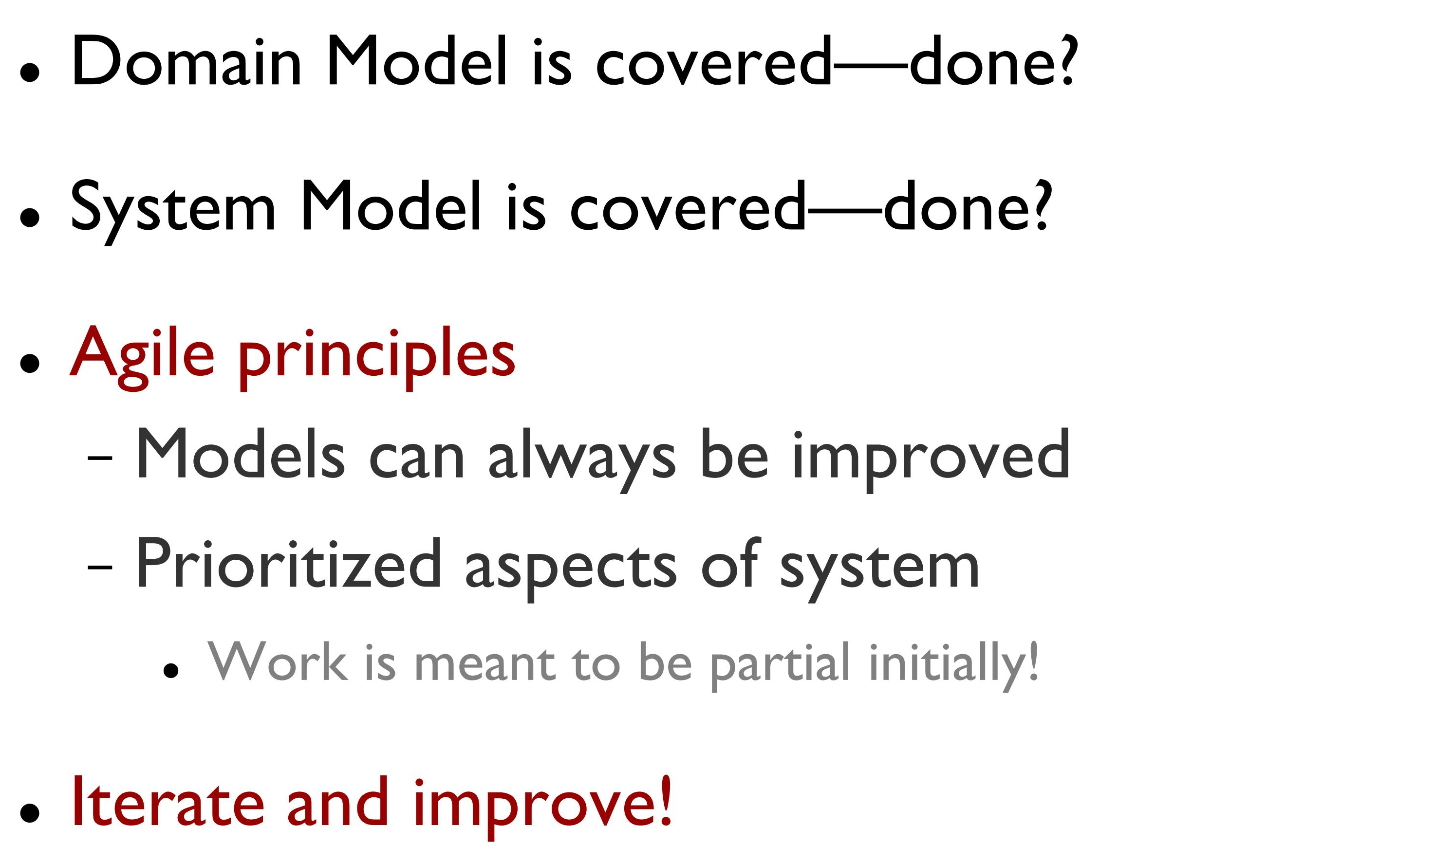
Remember Agile

Slide 4
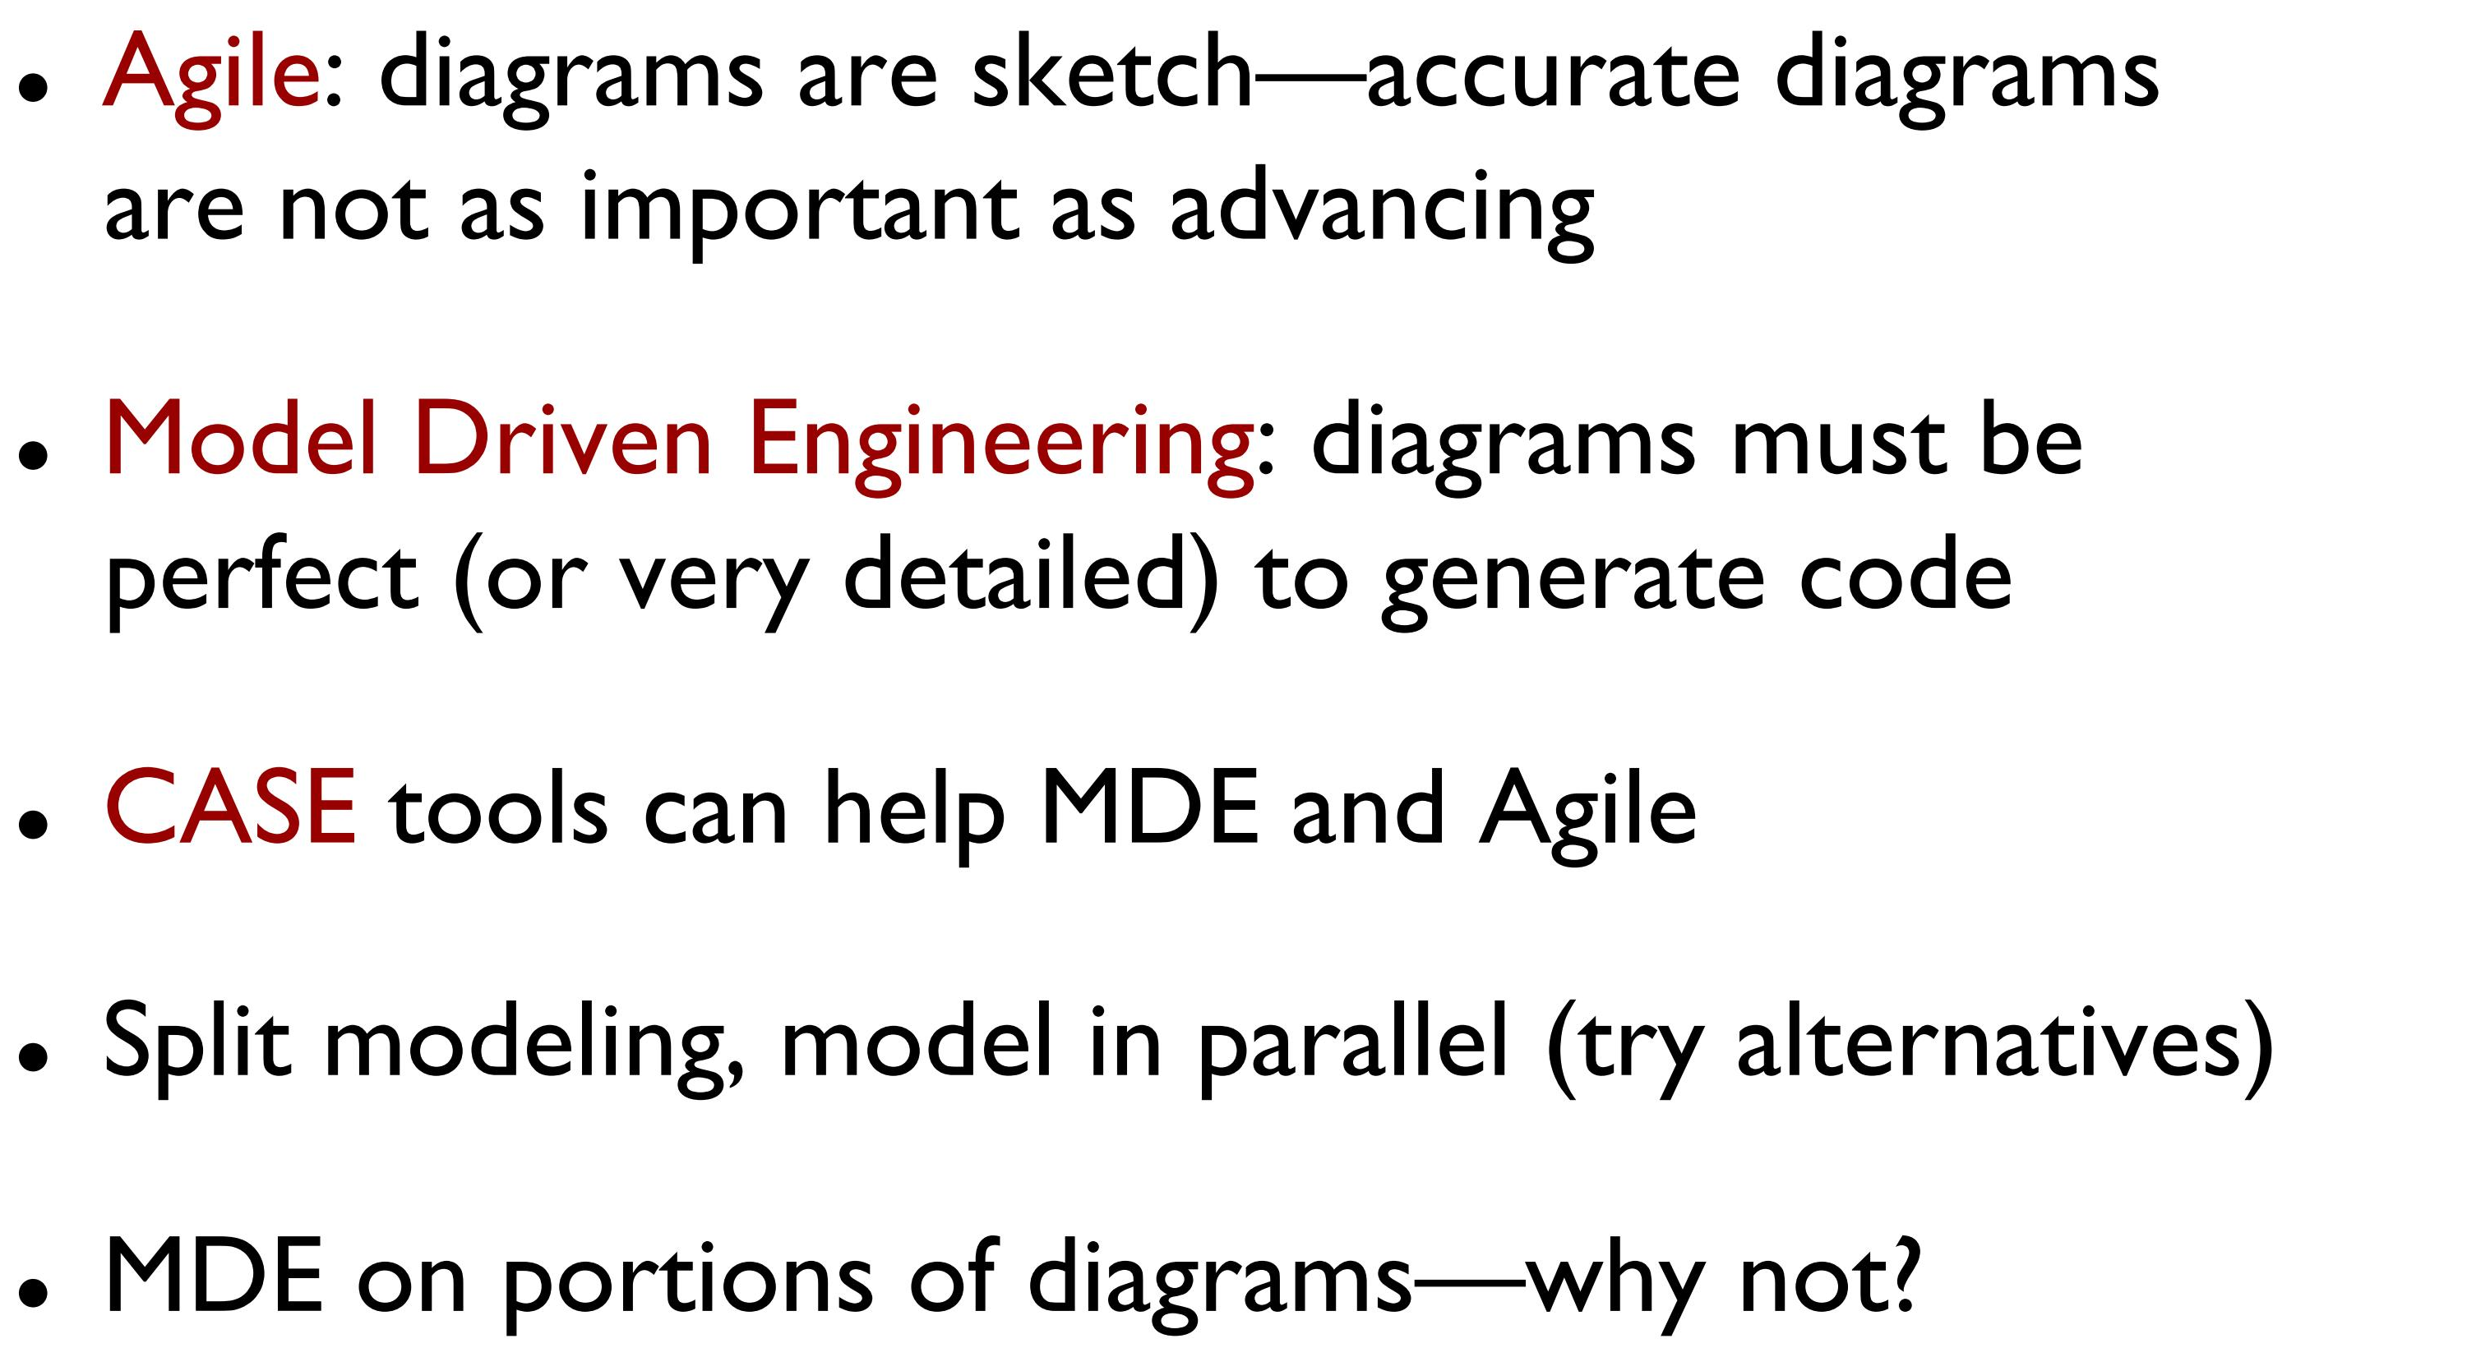
Approach to Diagrams

Slide 5
Requirements to Design Iteratively
The requirements and object-oriented analysis has focused on learning to do the right thing
Design work will stress do the thing right
In iterative development, a transition from primarily a requirements or analysis focus to primarily a design and implementation focus will occur in each iteration.
Provoking early change
Iterative and evolutionary methods "embrace change" although we try to provoke that inevitable change in early iterations
Early programming, tests, and demos help provoke the inevitable changes early on

Slide 7
Logical Architecture
The logical architecture is the large-scale organization of the software classes into packages (or namespaces), subsystems, and layers
A layer is a very coarse-grained grouping of classes, packages, or subsystems that has cohesive responsibility for a major aspect of the system
Layers are organized such that "higher" layers (such as the UI layer) call upon services of "lower" layers, but not normally vice versa.
Typically layers in an OO system include:
User Interface.
Application Logic and Domain Objects
Technical Services
Strict Vs Relaxed layered architecture

Slide 8
Layers shown with UML package diagram notation

Slide 9
Applying UML
UML package diagrams are often used to illustrate the logical architecture of a system.
A layer can be modeled as a UML package; for example, the UI layer modeled as a package named UI.
A UML package can group anything: classes, other packages, use cases, and so on.
A UML package is a more general concept than simply a Java package or .NET namespace
It is common to want to show dependency (a coupling) between packages so that developers can see the large-scale coupling in the system
The UML dependency line is used for this, a dashed arrowed line with the arrow pointing towards the depended-on package.

Slide 10
Alternate UML approaches to show package nesting, using embedded packages, UML fully-qualified names, and the circle-cross symbol

Slide 11
Guideline: Design with Layers
The essential ideas of using layers are simple:
Organize the large-scale logical structure of a system into discrete layers of distinct, related responsibilities, with a clean, cohesive separation of concerns such that the "lower" layers are low-level and general services, and the higher layers are more application specific.
Collaboration and coupling is from higher to lower layers; lower-to-higher layer coupling is avoided.

Slide 12
Guideline: Design with Layers
Using layers helps address several problems:
Source code changes are rippling throughout the system – many parts of the systems are highly coupled.
Application logic is intertwined with the user interface, so it cannot be reused with a different interface or distributed to another processing node.
Potentially general technical services or business logic is intertwined with more application-specific logic, so it cannot be reused, distributed to another node, or easily replaced with a different implementation.
There is high coupling across different areas of concern. It is thus difficult to divide the work along clear boundaries for different developers.

Slide 13
Benefits of Using Layers
In general, there is a separation of concerns, a separation of high from low-level services, and of application-specific from general services. This reduces coupling and dependencies, improves cohesion, increases reuse potential, and increases clarity.
Related complexity is encapsulated and decomposable.
Some layers can be replaced with new implementations. This is generally not possible for lower-level Technical Service or Foundation layers (e.g., java.util), but may be possible for UI, Application, and Domain layers.
Lower layers contain reusable functions.
Some layers (primarily the Domain and Technical Services) can be distributed.
Development by teams is aided because of the logical segmentation.

Slide 14
Common layers in an information system logical architecture

Slide 15
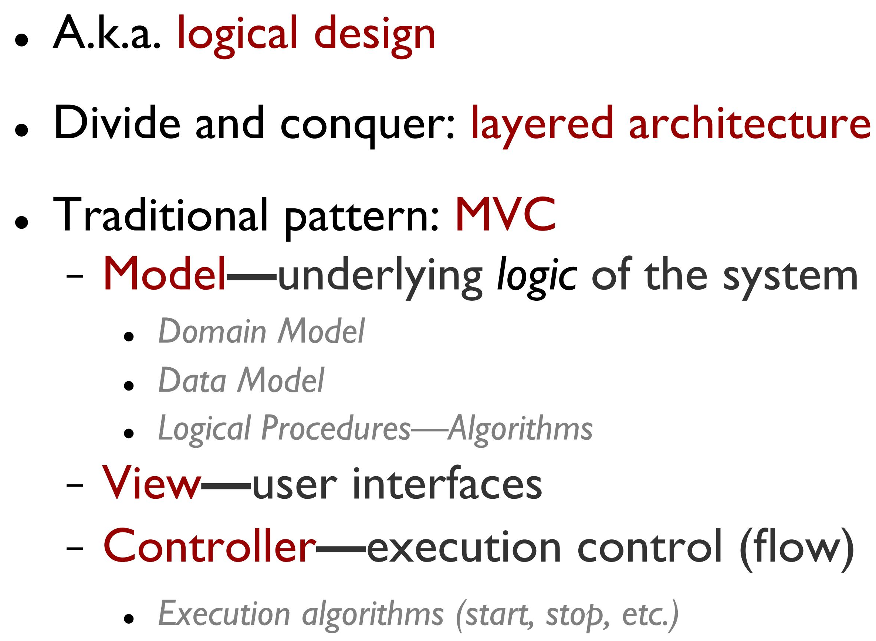
Design: Architecture

Slide 16
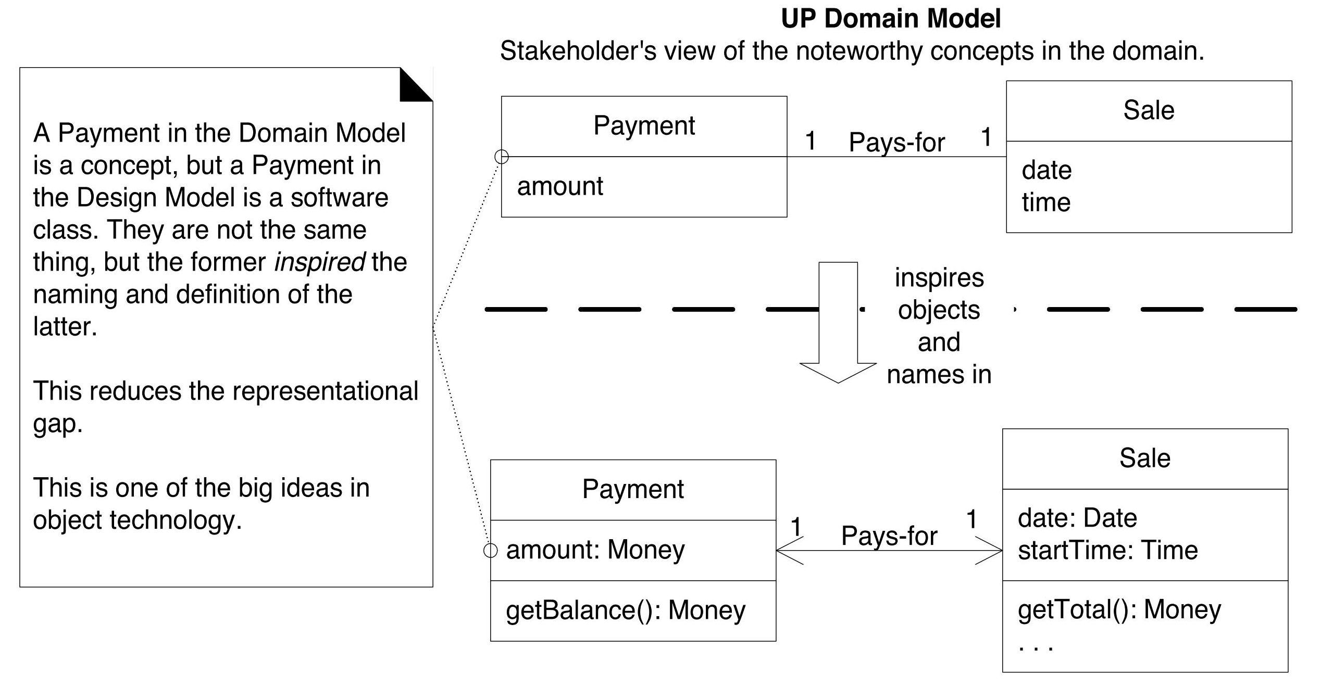
Domain layer and domain model relationship

Slide 17
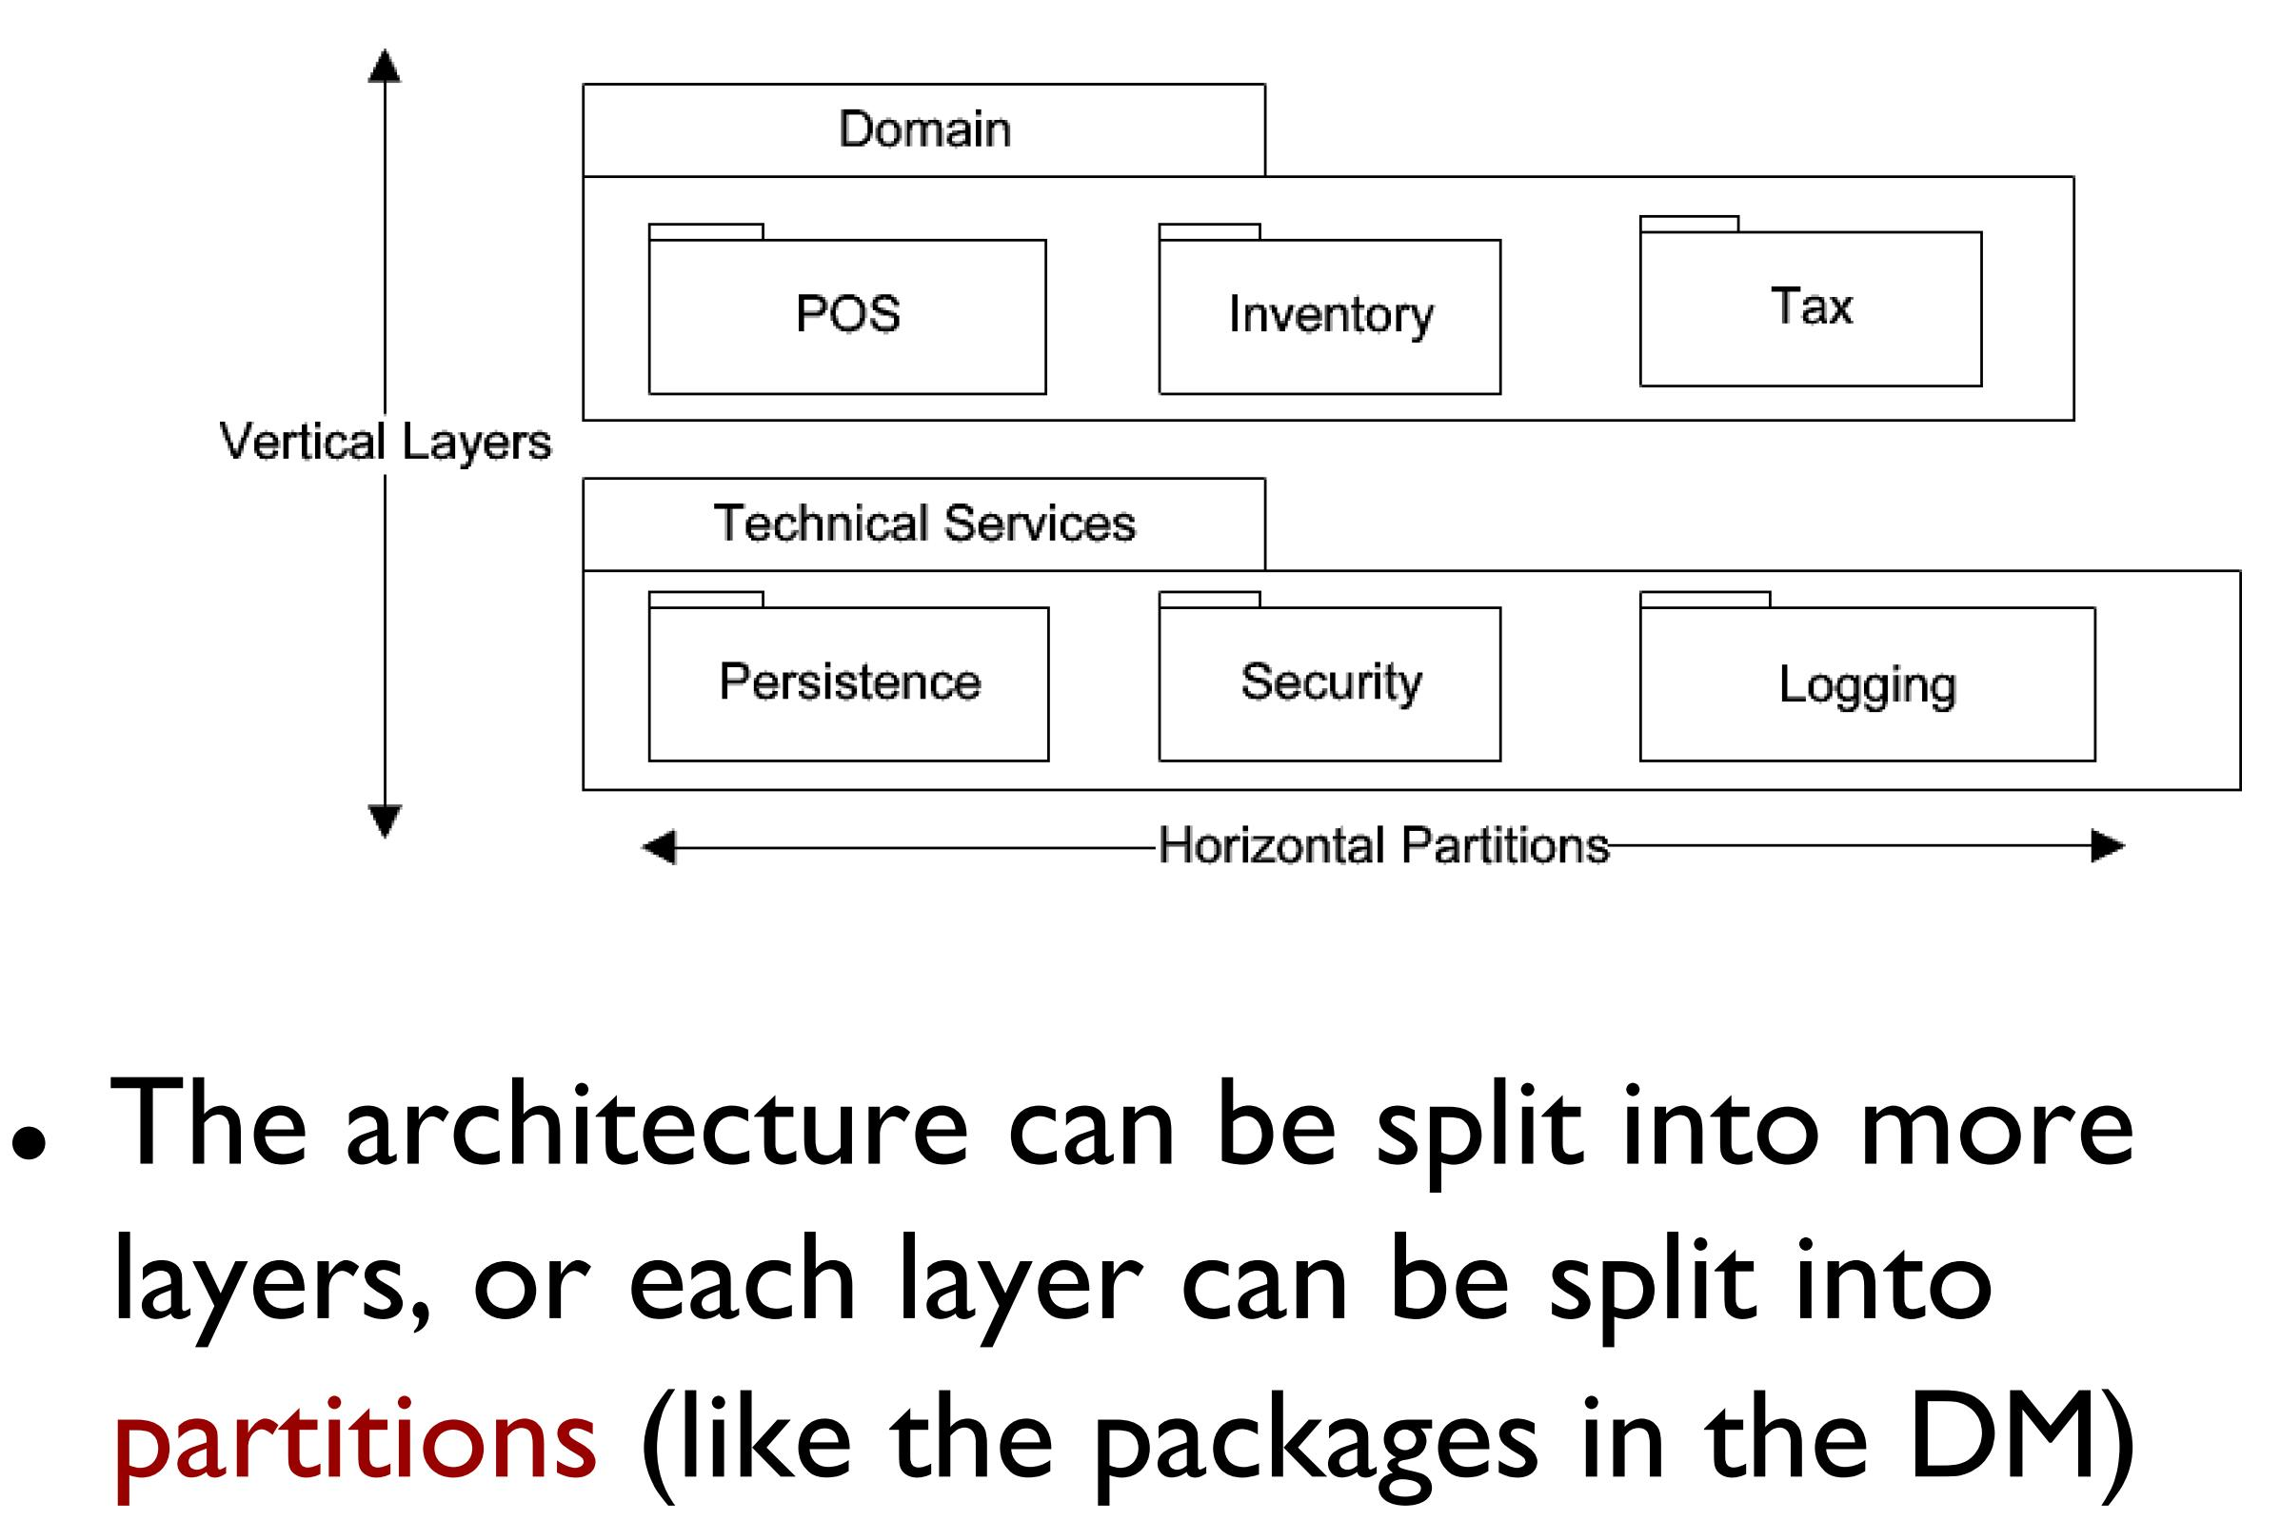
Layers and Partitions

Slide 18
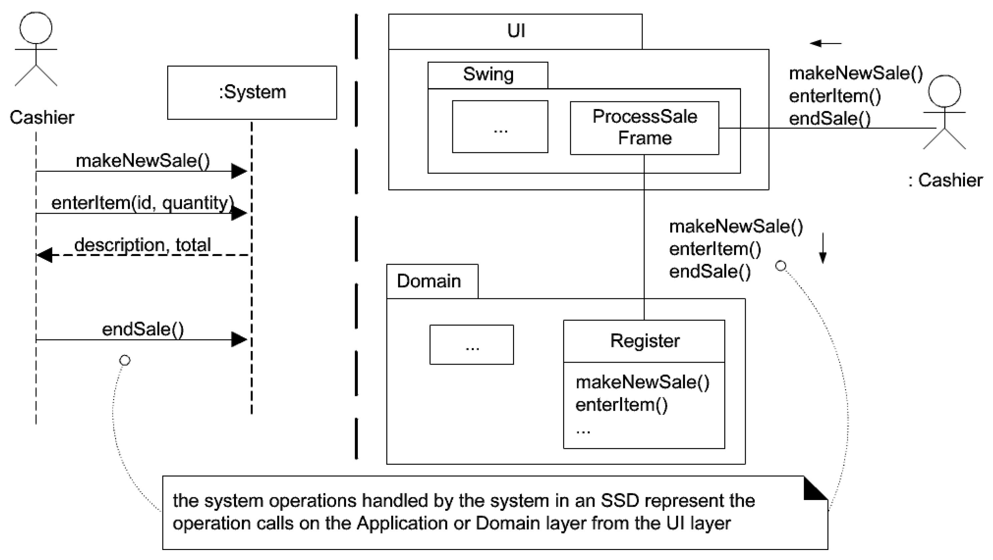
Design: Architecture

Slide 19
Guideline: Model-View Separation Principle
This principle has at least two parts:
Do not connect or couple non-UI objects directly to UI objects. For example, don't let a Sale software object (a non-UI "domain" object) have a reference to a Java Swing JFrame window object. Why? Because the windows are related to a particular application, while (ideally) the non-windowing objects may be reused in new applications or attached to a new interface.
Do not put application logic (such as a tax calculation) in the UI object methods. UI objects should only initialize UI elements, receive UI events (such as a mouse click on a button), and delegate requests for application logic on to non-UI objects (such as domain objects).

Slide 20
Recommended Reading
Chapter # 12 and 13 from Applying UML and Patterns: An Introduction to Object-Oriented Analysis and Design and Iterative Development by Craig Larman, 3rd Edition

